Slide 1
Digital Portfolio
STUDENT NAME: S.Sanjana
REGISTER NO AND NMID:42132120500122026
6D3EA6BE66AA388A3B3428D31798E15C
DEPARTMENT: BCA
COLLEGE: COLLEGE/ UNIVERSITY

Slide 2
PROJECT TITLE
Student portfolio

Slide 3


AGENDA
Problem Statement
Project Overview
End Users
Tools and Technologies
Portfolio design and Layout
Features and Functionality
Results and Screenshots
Conclusion
Github Link
3/21/2024 Annual Review

Slide 4

PROBLEM STATEMENT
In today;s digital age, traditional techniques alone are not sufficient to showcase students skillsets and knowledge.
5 line of ps

Slide 5

PROJECT OVERVIEW
. portfolio contains about me, project, skills contact, and pictures
.main idea:
.4 to 5 lines

Slide 6

WHO ARE THE END USERS?
Students
Job seekers
Professional
Software
And so on

Slide 7

TOOLS AND TECHNIQUES
HTML-PAGES, SECTIONS
CSS-LAYOUT, COLORS,FONT
JAVASCRIPT-INTERACTIVE,NAVIGATION, FORM
VALIDATION
VS CODE-IMPLEMENTATION CODE EDITOR,GITHUB CODEPEN.

Slide 8
POTFOLIO DESIGN AND LAYOUT
Section
Home
Project
Skills
Contact
Mobile/Desktop/tablet
Detailed explanation
8

Slide 9
FEATURES AND FUNCTIONALITY
Navigation BAR with smooth scrolling
Image details/hyperlinks
Interactive elements-animations, hover effects, background
Colour change
Contact form validation
Responsive design for different devices

Slide 10
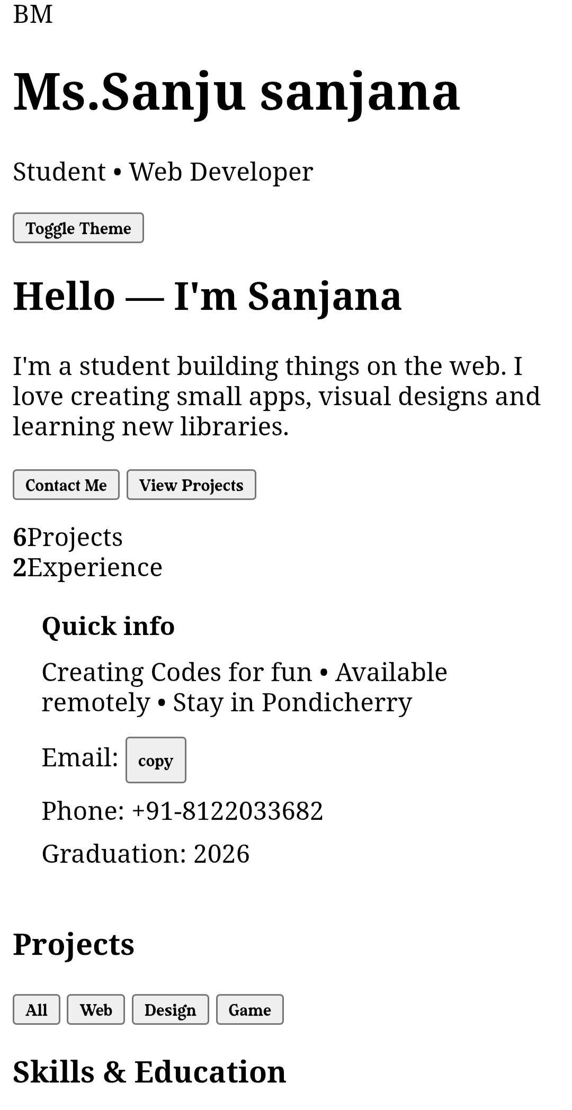

RESULTS AND SCREENSHOTS
3/21/2024 Annual Review
10

Slide 11
CONCLUSION
The Student Portfolio Website provides an effective online platform for students to present their personal details, skills, and projects in a professional way. Unlike traditional paper resumes, this website is interactive, easy to access, and visually appealing. It is developed using the fundamentals of web development — HTML for structure, CSS for design, and JavaScript for interactivity. The project not only helps students showcase their profile to recruiters and faculty but also improves their practical knowledge in creating and hosting websites. Overall, this project demonstrates the importance of web technologies in building a personal brand and enhancing career opportunities.
11

